Slide 1
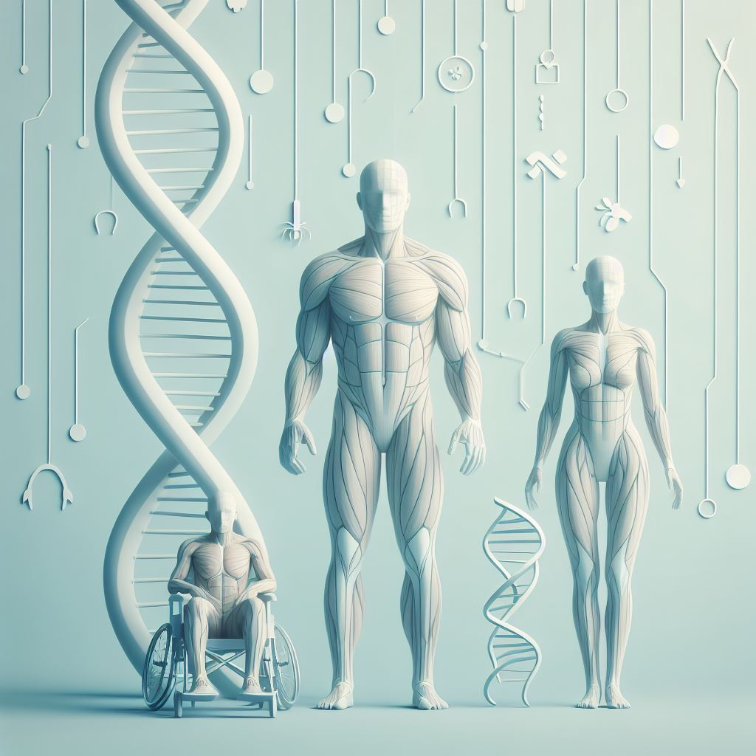
Transcriptomic analysis of paired healthy human skeletal muscles to identify modulators of disease severity in DMD
Shirley Nieves-Rodriguez, Florian Barthélémy, Jeremy D. Woods, Emilie D. Douine, Richard T. Wang, Deirdre D. Scripture-Adams, Kevin N. Chesmore, Francesca Galasso, M. Carrie Miceli,Stanley F. Nelson
Front. Genet. 14:1216066., 2023

Slide 2
Introduction
Duchenne Muscular Dystrophy – most common childhood onset dystrophy
Caused by a single gene mutation in DMD, dystrophin coding gene
Miofibers death and fibrosis
Different progression
Genetic, yet 1/3 is not hereditary
Some muscles are spared
Proximal muscles are more affected

Slide 3
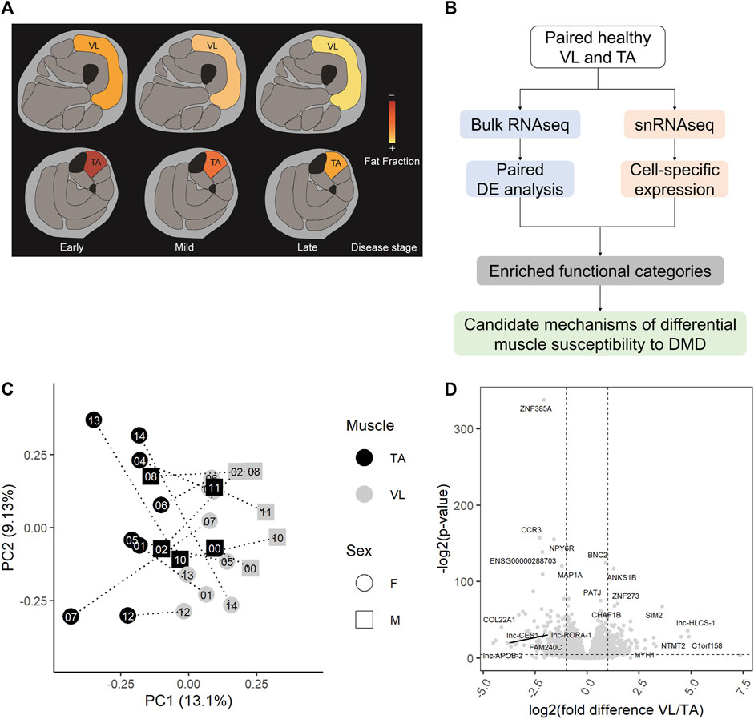
Goals
Goal of the study: analyze transcriptomic differences
My goal: rerun the analysis, change of workflow and tools, add batch correction and use of updated transcriptome for H. sapiens
Challenges: authors described biological mehods very well, but very little about their bioinformatics steps

Slide 4
Materials and methods
Data from RNA-Seq obtained by the authors of the study:
41 biosamples, 8 DMD patients, 35 control samples, standard Illumina protocols, study id: PRJNA976807 – raw RNA-Seq data
Biopsies of Tibialis ant. and Vastus lat. Muscles from healthy controls, TA biposies from children with Duchenne’s
Quantification of transcript abundance using Salmon, Genocode.v46 transcriptome as reference
Differential expression analysis using DESeq2
GO enrichment analysis using clusterProfiler
Single cell analysis with Seurat

Slide 5
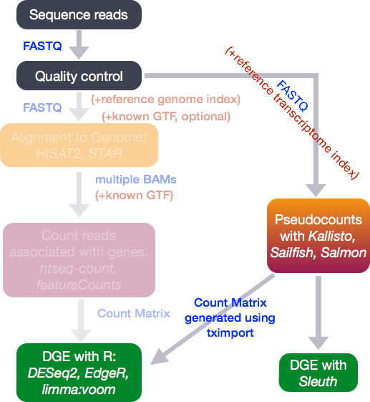
Counting or quantifying
Different approach
Traditionally (and in original publication): mapping to reference genome
Quantifying to reference transcriptome, e.g. with Salmon

Slide 6
Transriptional differences between VL and TL
27 total muscle smaples form 14 individuals
3283 differently expressed genes ~ the original analysis
LFC > 0 (up) : 1652, 4.2% LFC < 0 (down) : 1631, 4.2%

Slide 7
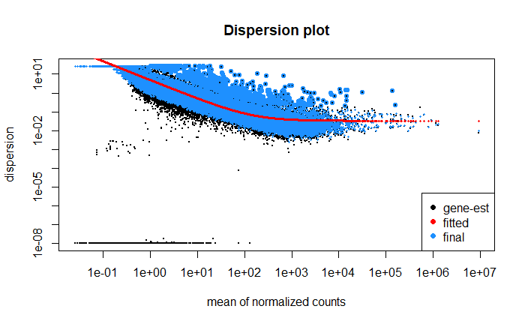
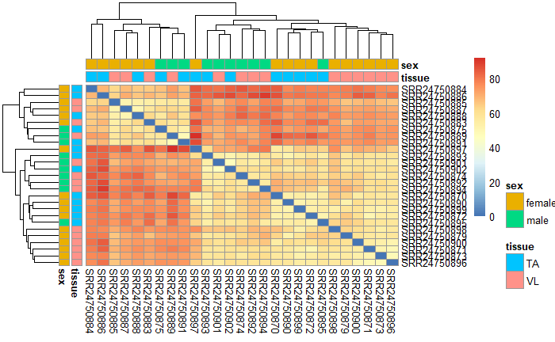
Transriptional differences between VL and TL

Slide 8
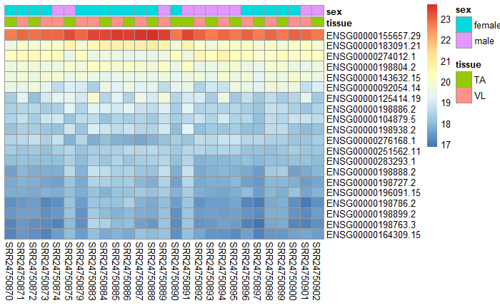
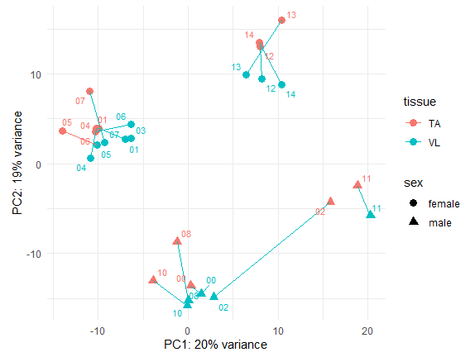
Transriptional differences between VL and TL
PCA
TOP 20 GENES

Slide 9
Transriptional differences between VL and TL
PCA
ORIGINAL PCA

Slide 10
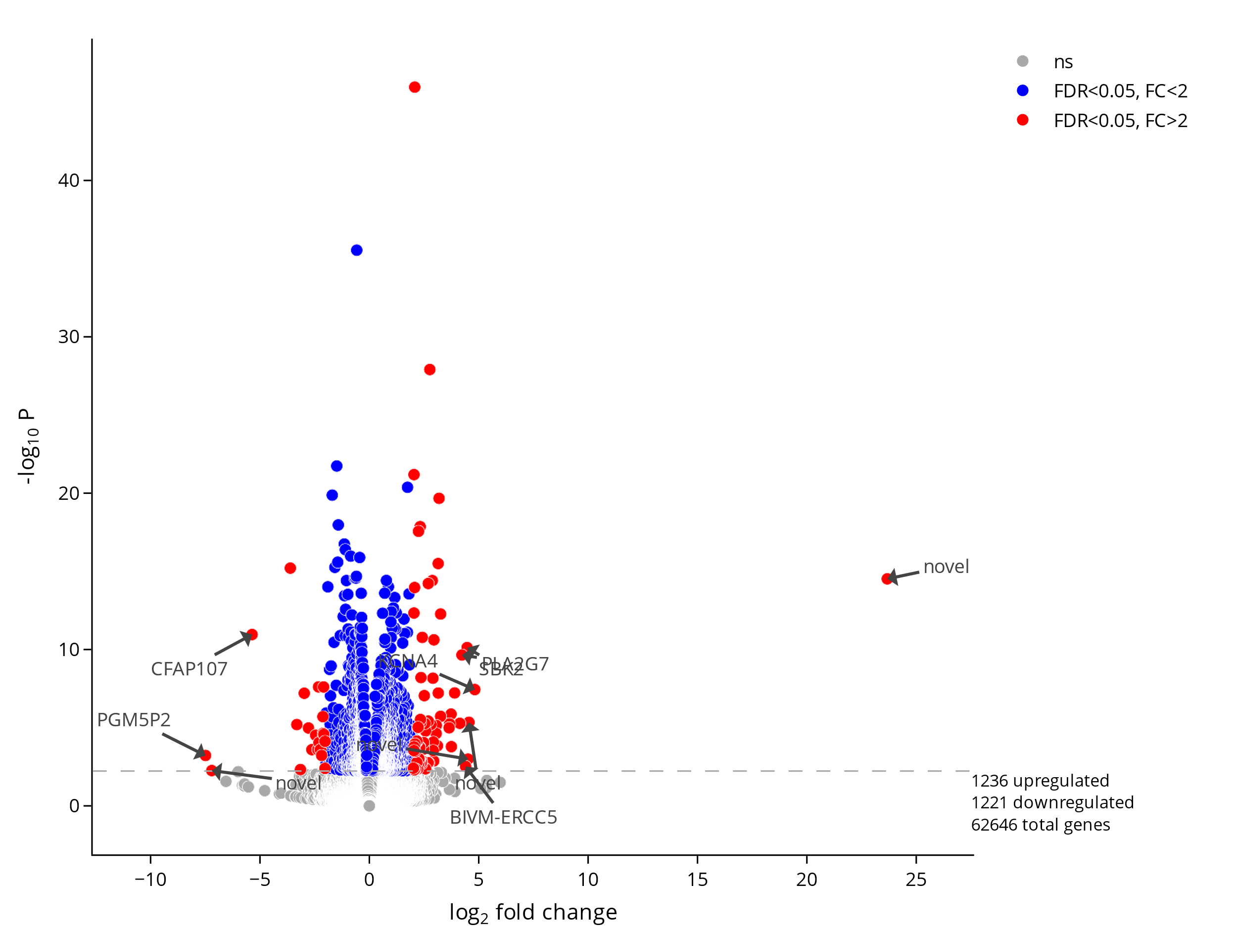
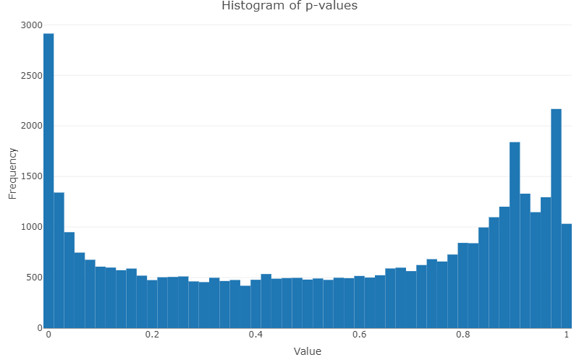
Transriptional differences between VL and TL
Volcano plot of differentially expressed genes
P-values histogram

Slide 11
GO – Biological processes
Description | p.adjust | qvalue | geneID
cytoplasmic translation | 2.08349341742393e-44 | 1.70517212200811e-44 | RPS20/YBX3/RPL18/YBX1/RPL31/RPS5/EIF3I/RPL6/RPLP0/EIF3L/RPL3/EIF3E/
muscle system process | 2.31024101993353e-25 | 1.89074683383494e-25 | CD38/TBXA2R/ATP1A2/TNFRSF1B/MYOC/MYOM2/CYBA/KCNQ1
muscle contraction | 7.58658958975499e-24 | 6.20901461045268e-24 | CD38/TBXA2R/ATP1A2/MYOM2/KCNQ1/MYLK/CACNB1/KCNN2/CACNA1S
muscle cell development | 3.00377495514101e-19 | 2.45834869045351e-19 | KDM1A/MYOM2/ACTN1/CACNA1S/ZMPSTE24/TBX5/MYH7/CAPN3/NFATC4
muscle cell differentiation | 1.08776212948908e-18 | 8.90245989293452e-19 | KDM1A/IFRD1/CD9/EHD2/MYOM2/RORA/ACTN1/NFATC3/IL4R/CACNA1S
muscle tissue development | 9.97484411563735e-14 | 8.16360923683239e-14 | IFRD1/MYOM2/ELN/FOXC1/YBX3/MYLK/PITX1/CACNA1S/ZMPSTE24/TBX5
GO – Cellular components
cytosolic ribosome | 2.68784713607053e-47 | 2.17917281804598e-47 | RPS20/RPL18/RPL31/RPS5/RPL6/RPLP0/RPL3/GSPT1/RPS16/RPS19/RPL18A
focal adhesion | 3.97982400715076e-38 | 3.22664342796993e-38 | LASP1/CD9/PLAUR/VIM/CD44/TNC/SYNE2/NCKAP1/RPL18/CNN2/NHERF2
cell-substrate junction | 3.97982400715076e-38 | 3.22664342796993e-38 | LASP1/CD9/PLAUR/VIM/CD44/TNC/SYNE2/NCKAP1/RPL18/CNN2/NHERF2
ribosomal subunit | 5.76504877169704e-32 | 4.67401490560879e-32 | RPS20/MRPS24/RPL18/RPL31/RPS5/RPL6/RPLP0/RPL3/RPS16/RPS19
cytosolic large ribosomal subunit | 3.95923978551156e-31 | 3.20995476451329e-31 | RPL18/RPL31/RPL6/RPLP0/RPL3/RPL18A/RPL19/RPL34/RPL24/RPL22/RPL21
contractile fiber | 3.09763332792762e-27 | 2.5114070878159e-27 | MYOM2/SYNE2/ACTN1/FERMT2/KCNN2/CACNA1S/MMP2/MYH7/CAPN3

Slide 12
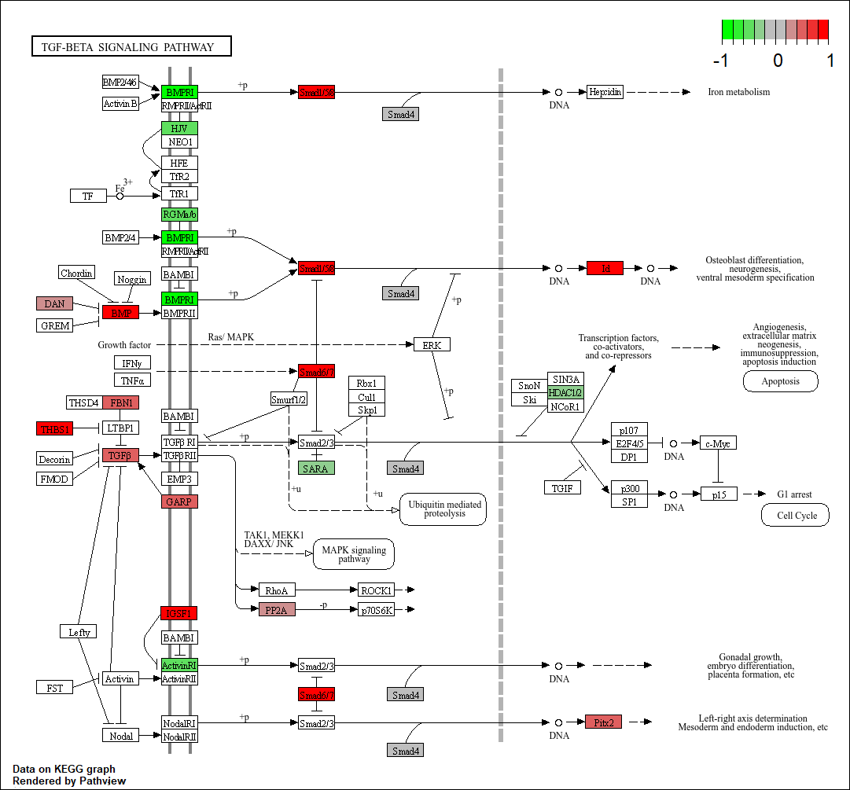
KEGG terms analysis
Key affected processes:
TGF-B signaling pathway
P53 signaling pathway
Calcium metabolism

Slide 13
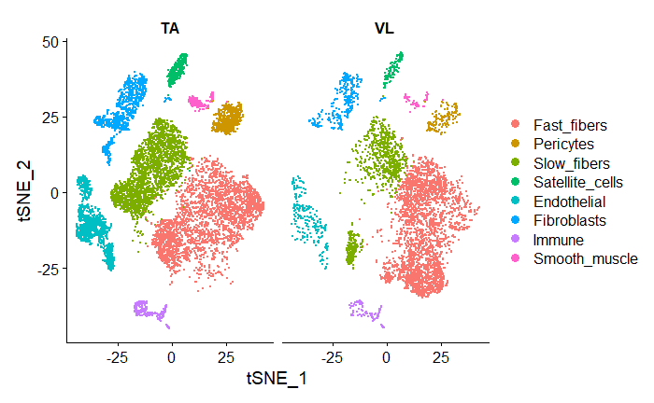
Cell types difference
Cell specific expression profiles – scRNA-Seq

Slide 14


Cell types difference
Cell specific expression profiles – scRNA-Seq
Different muscle composition
Fast and slow fibers content

Slide 15
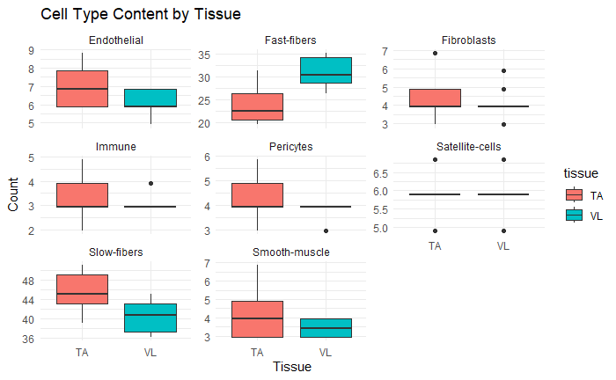
Bulk RNA cel content estimation
Marker genes in scRNA
Deconvolution using granulator
Only 645 of 3207 genes are mostly expressed in miocytes! Role of different cells in disease progression

Slide 16
Transriptional differences between DMD and healthy controls
27 total muscle smaples form 14 individuals
9586 differently expressed genes (compared to only ~600 in original paper)
LFC > 0 (up) : 5046, 13% LFC < 0 (down) : 4540, 11%

Slide 17
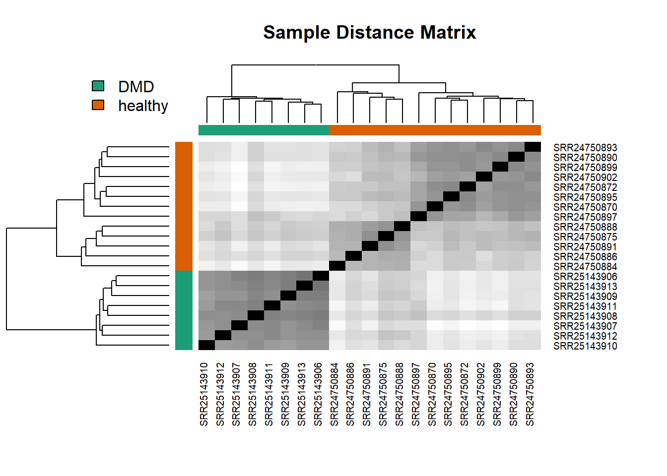
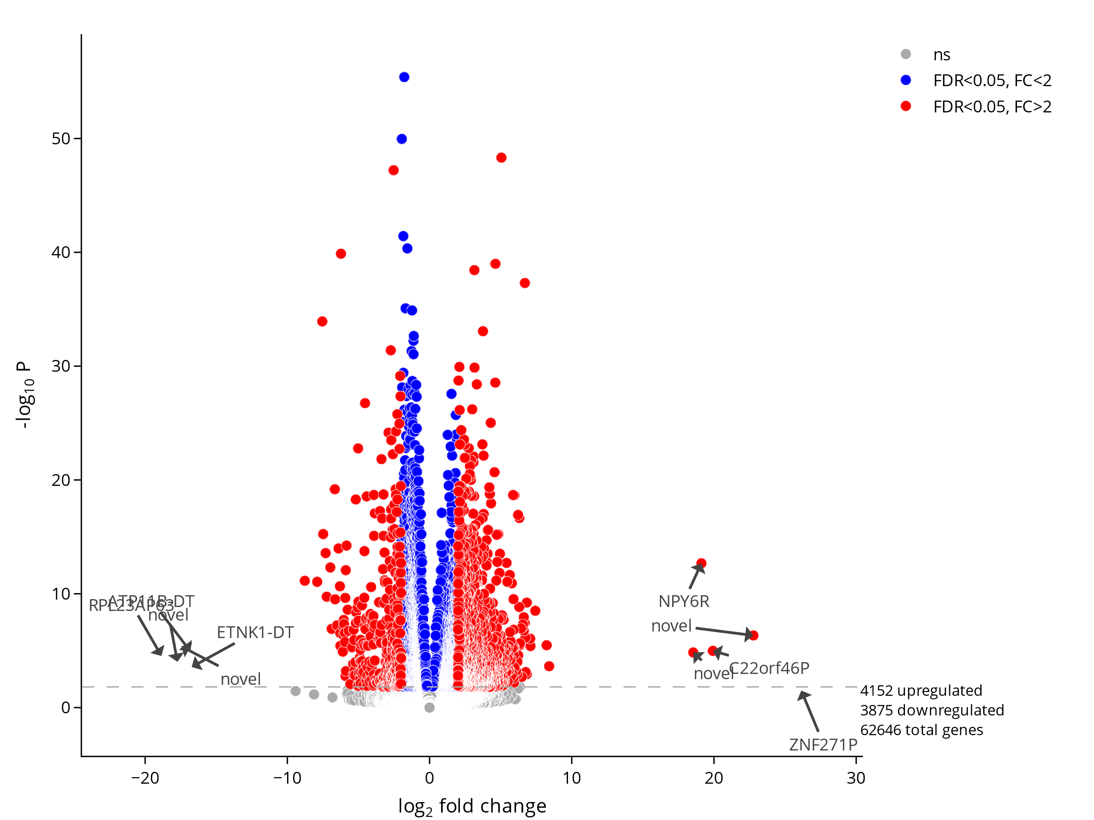
DMD and healthy controls
Strong batch effect – only males in DMD group, children in DMD and adults in healthy

Slide 18
GO Biological processes
GO Biological processes: DMD vs control
Description | p.adjust | qvalue | geneID
epithelial cell proliferation | 1.56E-05 | 1.29E-05 | TNMD/KRIT1/BAD/WNT16/CFLAR/ARX/DLX6/CCL26/PAX6/BTK/ALOX5/BID
mitotic cell cycle phase transition | 1.56E-05 | 1.29E-05 | MAD1L1/CDC27/KMT2E/USH1C/DBF4/E2F2/PKD1/ZNF207/DPF1/ANLN/BRCA1
regulation of nervous system development | 1.56E-05 | 1.29E-05 | SEMA3F/PLXND1/KDM1A/SOX8/TMEM98/ABCC8/CX3CL1/IFRD1/CDKL3
regulation of cell cycle phase transition | 1.56E-05 | 1.29E-05 | MAD1L1/KMT2E/DBF4/PAF1/CRY1/PKD1/METTL13/ZNF207/DPF1/ANLN/BRCA1
lipid transport | 1.56E-05 | 1.29E-05 | CFTR/SLC4A1/PON1/CROT/ABCB4/OSBPL7/NOS2/CRY1/STARD3NL/SYT7/NPC1L1
regulation of neuron projection development | 1.56E-05 | 1.29E-05 | SEMA3F/HECW1/CFLAR/SARM1/PLXND1/CD38/FKBP4/KDM1A/ARHGAP33
embryonic organ development | 1.56E-05 | 1.29E-05 | WNT16/DVL2/HOXA11/DLX6/USH1C/PAX6/TEAD3/PKD1/FUZ/MKS1/ERCC1

Slide 19
GO Biological processes: DMD vs control
Different processes than TA vs VL
Regulation of metabolism and cell cycle (compared to muscle function processes)
Predomninace of cells other than miocytes
TA - VL
6720
1307
1150
DMD - control

Slide 20
Summary
It was possible to recreate the study
Slightly different results: method? Incomplete data?
Identified many differentially expressed genes, estimated cel populations in bulk RNA
Unable to solve big drawback of the study: different age across groups, no data for healthy children muscle biopsies?
Software: Salmon, DESeq2, Seurat, granulator, clusterProfiler (GO, KEGG)
NEED FOR MORE PRACTICES TO MAKE RESEARCH REPRODUCTIBLE

